Slide 1
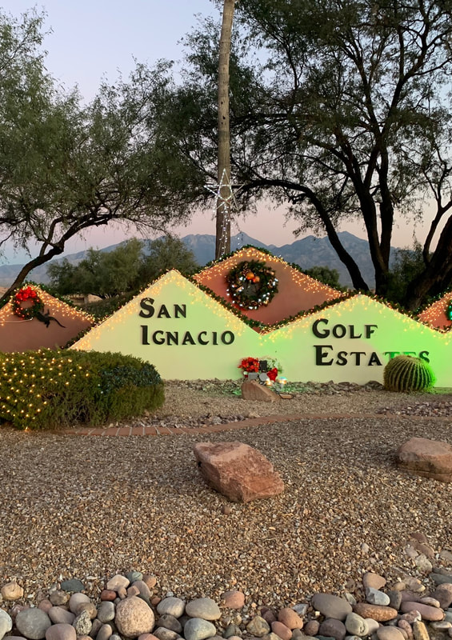
San Ignacio Golf Estates HOA Annual Meeting Canoa Hills GVR Center – Saguaro Room February 20, 2024

Slide 2
Welcome!
Meet your SIGE HOA Board of Directors
Shirley Kassebaum, President
John McKune, Vice President
Cindy Taylor, Treasurer
Sandy Ward, Secretary
Paul Smith, At-Large

Slide 3
Agenda
GENERAL MEETING
Call to Order
Establishment of Quorum
Welcome and Introduction
Reports:
President Report
Treasurer Report
Year End Financial Report
2024 Budget
Committee Reports
Road Committee
Landscape Committee
Architectural Review Committee
Social Committee
Announcement of 2023 Annual Meeting Minutes Results
Announcement of 2024 Election Results
Discussion Topics
Website Reminders
Homeowner Input and Feedback-Floor open to member comments
Please limit your time to approx. 3 minutes for each lot to allow all homeowners the opportunity to give input and feedback.
Adjournment
*An Organizational meeting of the Board may be held following the Annual meeting. This meeting is to appoint the officer positions of the Board and schedule the next Board of Directors meeting. This is an open meeting and homeowners are welcome to attend.*

Slide 4
Housekeeping
Restrooms
Please fill out Fair Housing Act Form
Coffee and Sweets
Short Board of Directors Meeting Following

Slide 5
Meet Stellar Property Management

Slide 6
President’s Report Shirley Kassebaum
What’s new this year – dues, restricted roads fund, landscaping, new management company, updated entrance way
Appreciation for those we’ve lost this year
Richard Kidwell
Larry Fields
Jerry Sompont

Slide 7
Treasurer’s Report Cindy Taylor
Financial Report
2024 Budget

Slide 8
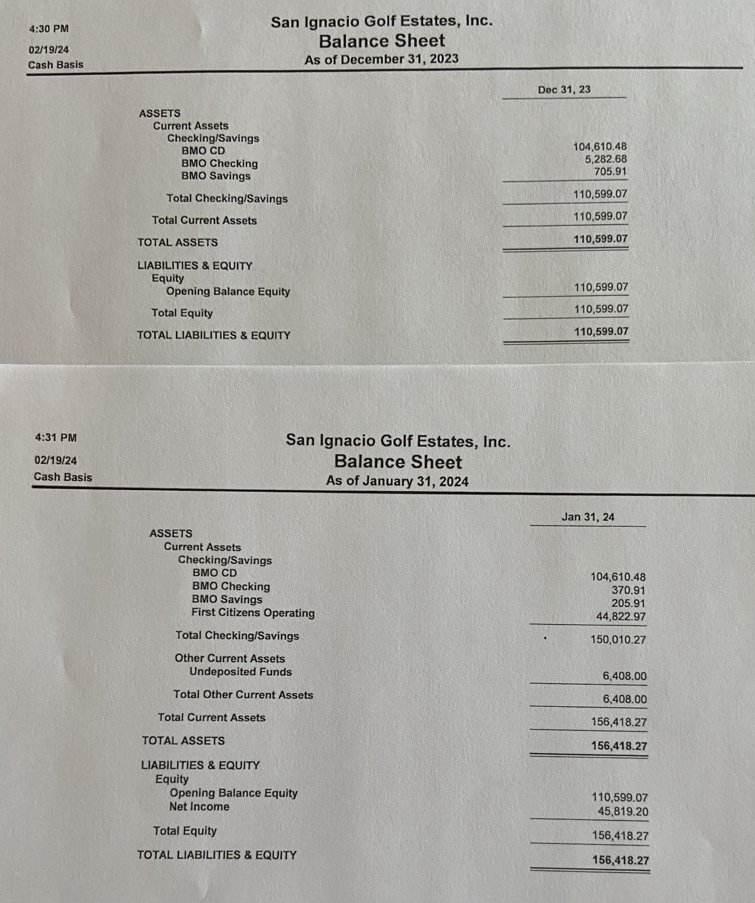
SIGE HOA Financials
$30,000 will be moved over from the CD to SIGE HOA savings
The balance in the checking account will be moved over to a new restricted capital reserve account for roads along with $74,610.48 from the CD. We will ladder up some CDs and add the $54,000 from the special assessment in June to the roads fund, so at the end of 2024, we will have $128,610.48 plus some interest in the restricted roads fund and we will build from there.

Slide 9
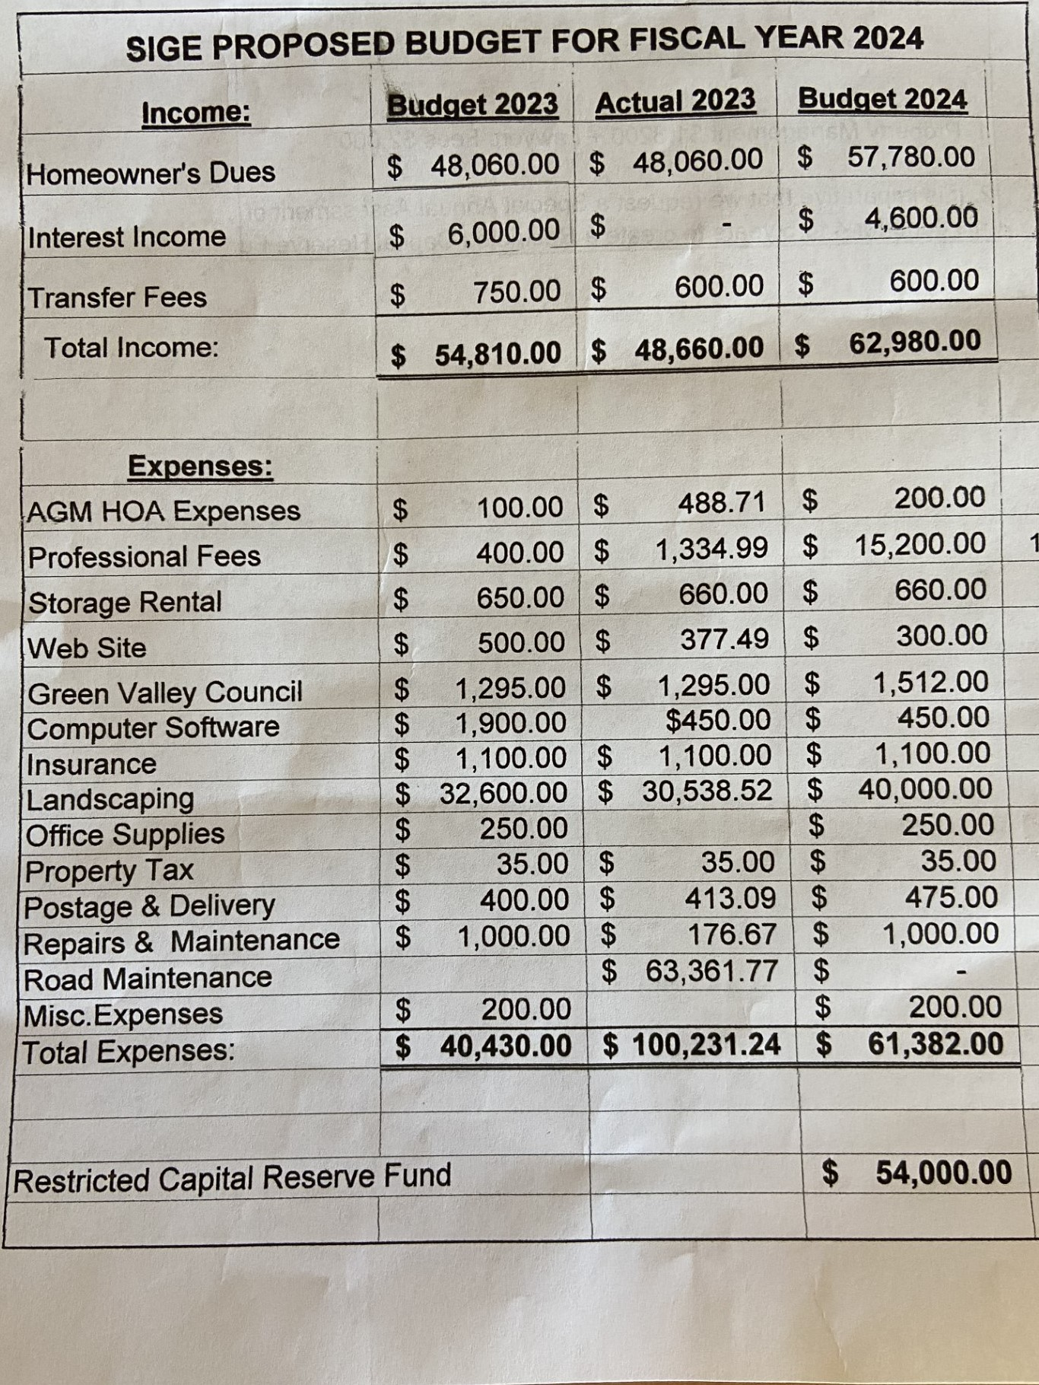
SIGE HOA 2024 Budget
Professional Fees: Property Management $13,200 + Legal Fees of $2,000
Restricted Capital Reserve Road Fund: Special Assessment $500 per

Slide 10
Road Committee Report Pat Nummi, Floyd White, Tim Morrisey
Bates Paving project 2023 Recap
Looking Ahead – Restricted Road Fund
Large vehicles Prohibited or Permit Required?

Slide 11
Landscape Committee Report Mary Grace Werner/Cindy Radford (co-chairs), Shirley Kassebaum, Julie Rogoski, Judy Maury
Schedule of Work on Website
Common Area Tree Policy
Request for Common Area Maintenance on Website
Summer Weed Control Form on Website

Slide 12
Architectural Review Committee Report John McKune, Bish Wheeler, Jim Reed, Cindy Taylor, Fred Callender
CCRs on Website – Please Review
New Paint Colors – Example is on the check-in table and on the website
ARC Request Form

Slide 13
Social Committee Report Debbie Reed/Jill Eiber co-chairs, Bev White, Shirley Kassebaum
#1 Pot Luck Dinner April (Fools Day)
Are you interested? Inside or outside?
#2 Ladies Luncheon March 2024
Next luncheon will be at Stables in Tubac on March 13, 2024 (tentative) Summer Ladies Luncheon?
#3 HAPPY HOURS
Sign up sheet. Once a week? Once a month? At homes? At GVR locations?
#4 SUGGESTIONS:
Any other suggestions for activities in the neighborhood related to the Social Committee please contact Debbie, Bev or Jill

Slide 14
Results of 2023 Annual Meeting Minutes
We need a motion from the floor to accept the 2023 AGM meeting minutes.

Slide 15
Results of the 2024 At-Large Election
Paul Smith – re-elected for a one-year term for SIGE HOA At-Large Representative to the Board

Slide 16
SIGE HOA Website & Other Important Information SIGE Secretary, Sandy Ward
San Ignacio Golf Estates HOA - Home (sigegv.org)
1
Green Valley Council (gvcouncil.org)
2
Fire Corps - Green Valley Fire District (gvfire.org)
3

Slide 17
Homeowner Questions, Input and Feedback - Floor Is Open
Please limit your time to under three minutes to allow all homeowners the opportunity to give input and feedback.
Rules:
Be respectful
Keep it friendly, not personal
Tell us what we are doing right?
Tell us how we can improve?

Slide 18
Thank you!
Stellar Property Management - Tammy Censky – tammy@stellarpmllc.com
San Ignacio Golf Estates, Inc., c/o Stellar Property Management, LLC, P.O. Box 18108, Tucson, Arizona, 85731
SIGE HOA email – sigehoa@yahoo.com
SIGE website – www.sigegv.org

